Slide 1
Velocity - Time Graphs

Slide 2
Review of our last time together
We learned about:
The idea of average velocity as v_{ave} = ——————
The idea of acceleration as acceleration = ———————
Displacement, Velocity, and Acceleration are VECTOR QUANTITIES (direction matters!)
Displacement
Time Taken
Change in Velocity
Time Taken
Notes:
About 1 min

Slide 3
This is a controller for a radio controlled car.
What do the two sliding buttons on this device do?
What do you suppose happens to the car when you push the left slider up?
What do you suppose happens to the car when you move the left slider down?
Notes:
Allow 2 mins, then 1 for discussion (4 tot)

Slide 4
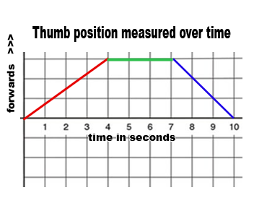
Let’s look a little deeper…
Take a Hot Wheels car, and try to create the motion that might arise from moving a thumb on the controller as shown right >>
What is happening to the velocity car at the following times?
0 - 4 seconds (RED)
4 - 7 seconds (GREEN)
8 - 10 seconds (BLUE)
What would the graph look like if the car moved backwards instead of forward?
Notes:
Allow 3 mins tot (1 to try + 2 to discuss) - [8 tot]

Slide 5
Let’s take a look at the following problem, involving a box:
The box moves in one-dimension where the positive direction is to the right and the negative direction is to the left.
The box can either be pushed with a force to the right, be pushed with a force to the left, or not be pushed at all.

Slide 6
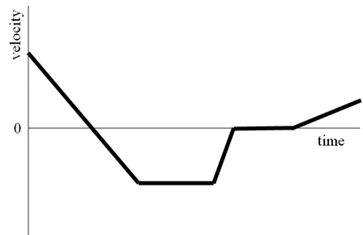
Let’s take a look at the following problem:
The box moves in one-dimension where the positive direction is to the right and the negative direction is to the left.
The box can either be pushed with a force to the right, be pushed with a force to the left, or not be pushed at all.
Over time, the box moves and the velocity is plotted on a graph. The graph is shown to the right →

Slide 7
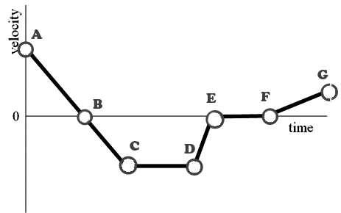
For each point on the graph determine if the box is…
Moving to the right (Color these ponts RED)
Stopped (Color these points GREEN)
Moving to the left (Color these points BLUE)

Slide 8
Change in Velocity
Time Taken
Remember that we found that: acceleration = ————————

Slide 9
Change in Velocity
Time Taken
Remember that we found that: acceleration = ————————
We now know that:
A positive slope corresponds with a positive acceleration, and a force to the RIGHT
A negative slope corresponds with a negative acceleration, and a force to the LEFT

Slide 10
Finally, we can look at the TOTAL DISPLACEMENT for the box:
average velocity is v_{ave} = ——————
Displacement
Time Taken
This must mean that:
We can find displacement by multiplying:
Average Velocity
X
Time taken

Slide 11
Finally, we can look at the TOTAL DISPLACEMENT for the box:
Displacement shows up as AREA
Where does the box end up?
Which has the greater area: Red or Blue?
Could the areas of the red shapes be equal to the area of the blue?

